Slide 1
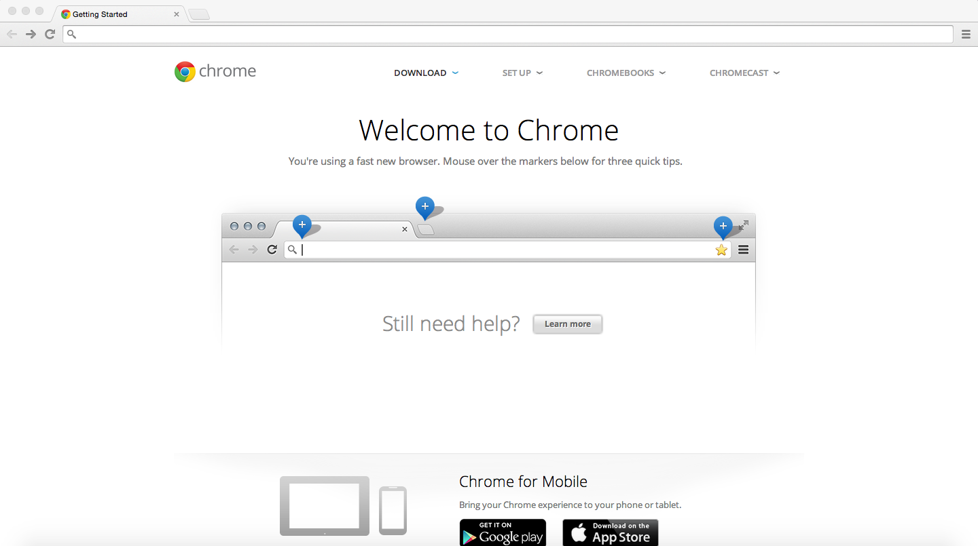
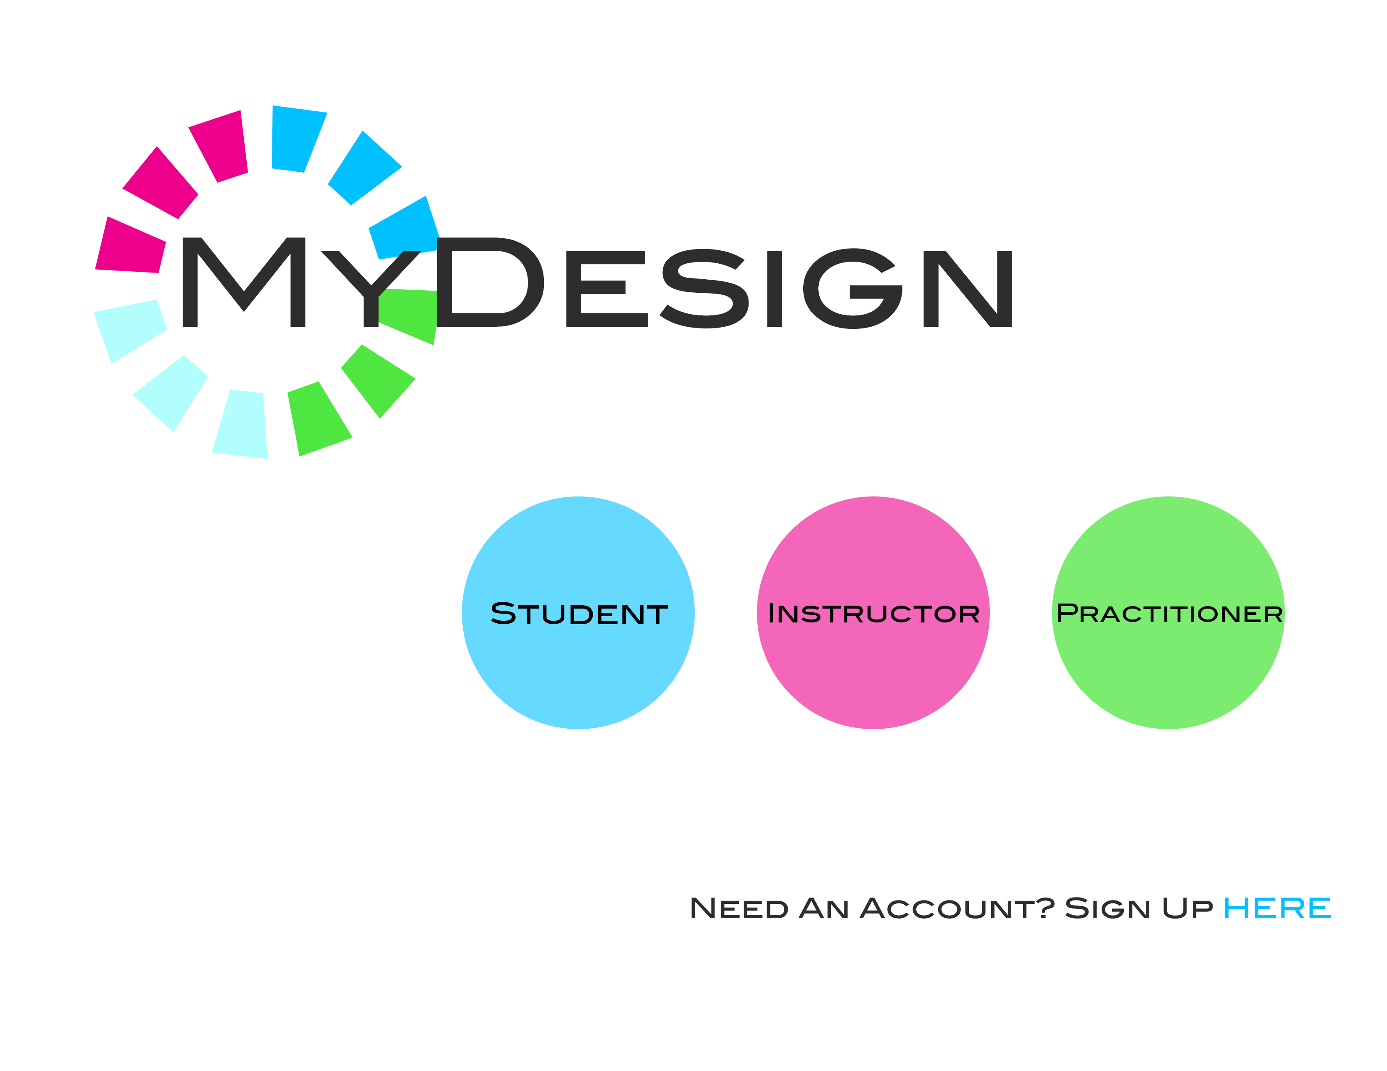

MyDesign

Slide 2
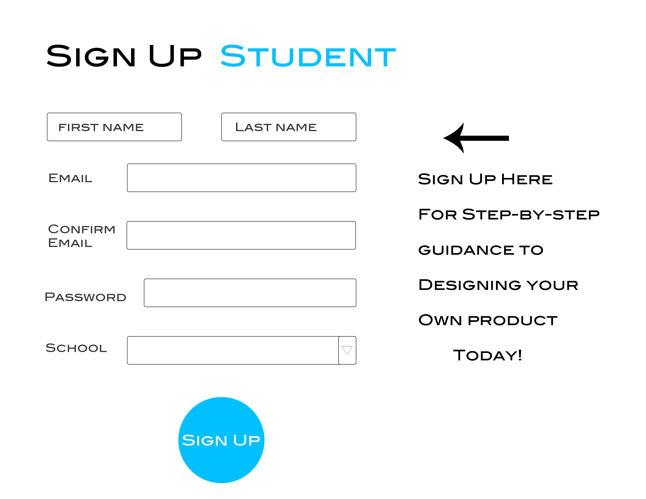
MyDesign
CLICK HERE
TO SIGN UP

Slide 3
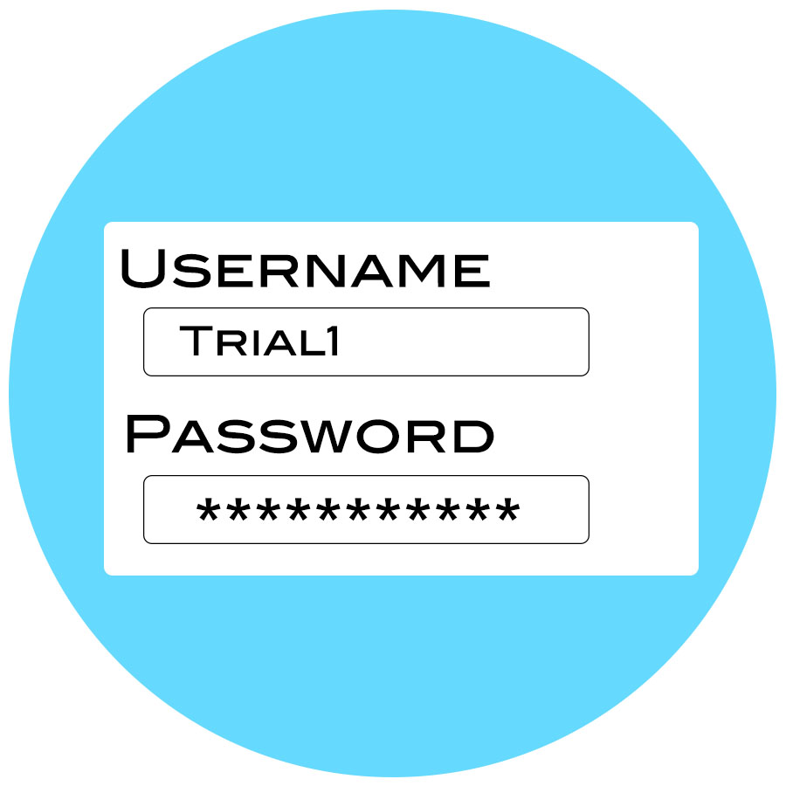
MyDesign
CLICK HERE
THEN SIGN IN

Slide 4
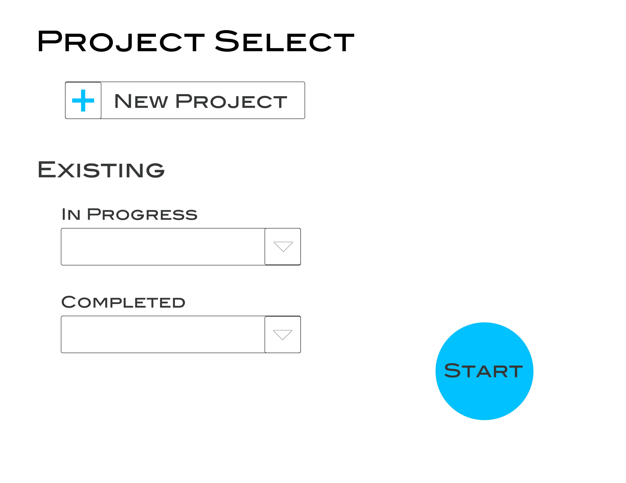
MyDesign
CLICK HERE

Slide 5
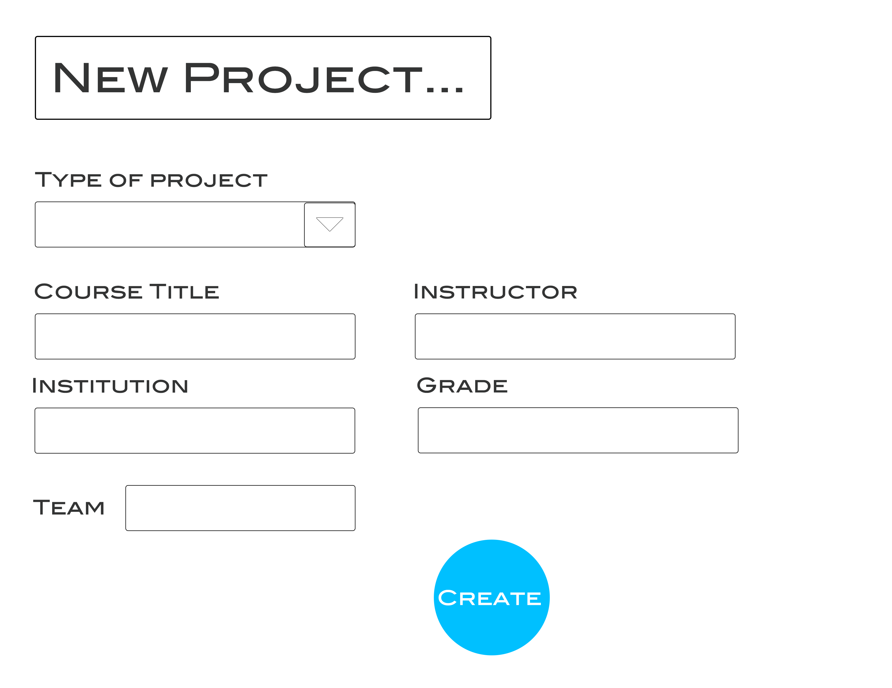
MyDesign
CLICK HERE

Slide 6
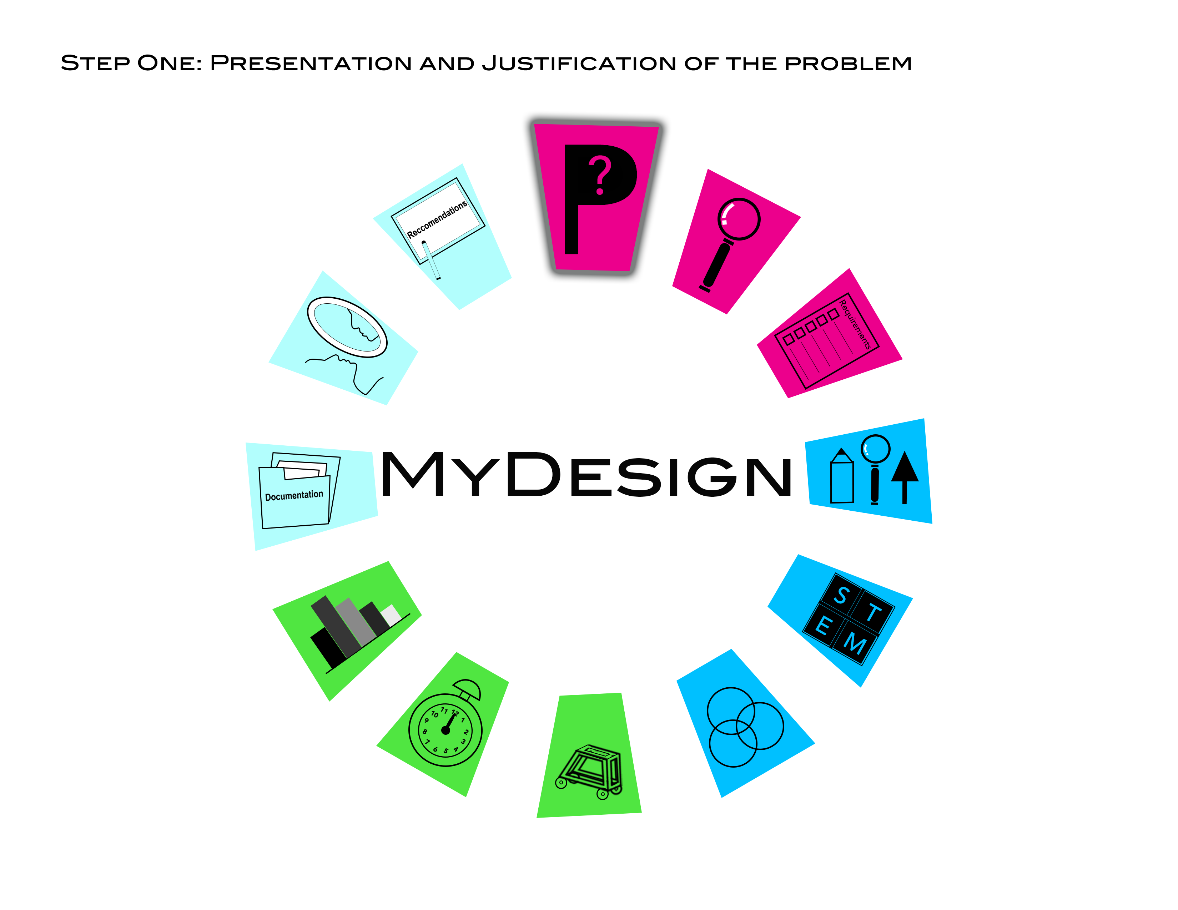
MyDesign
New project takes user
to step one of the design
process
Return to Project Select

Slide 7
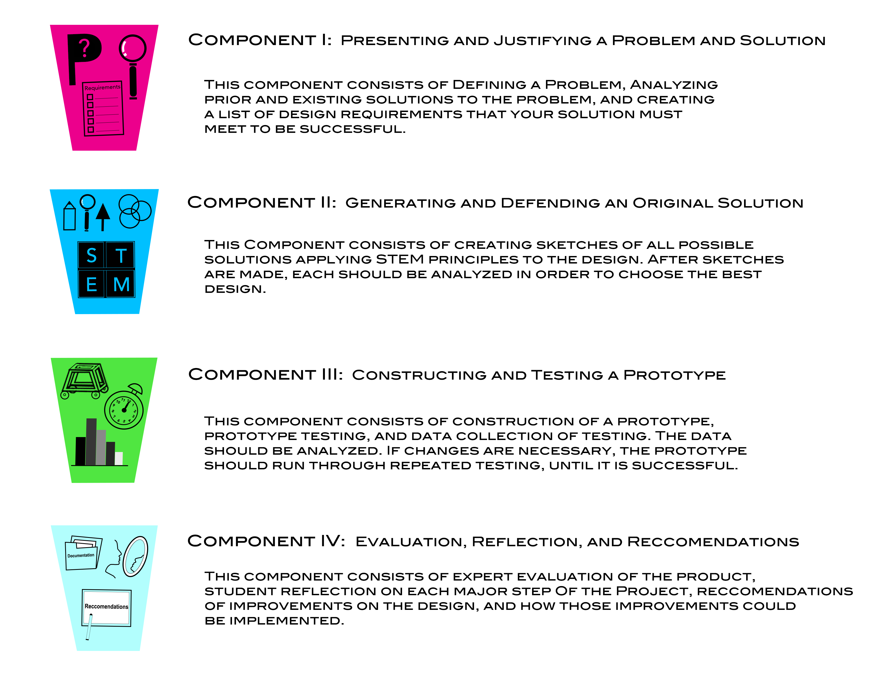

Slide 8
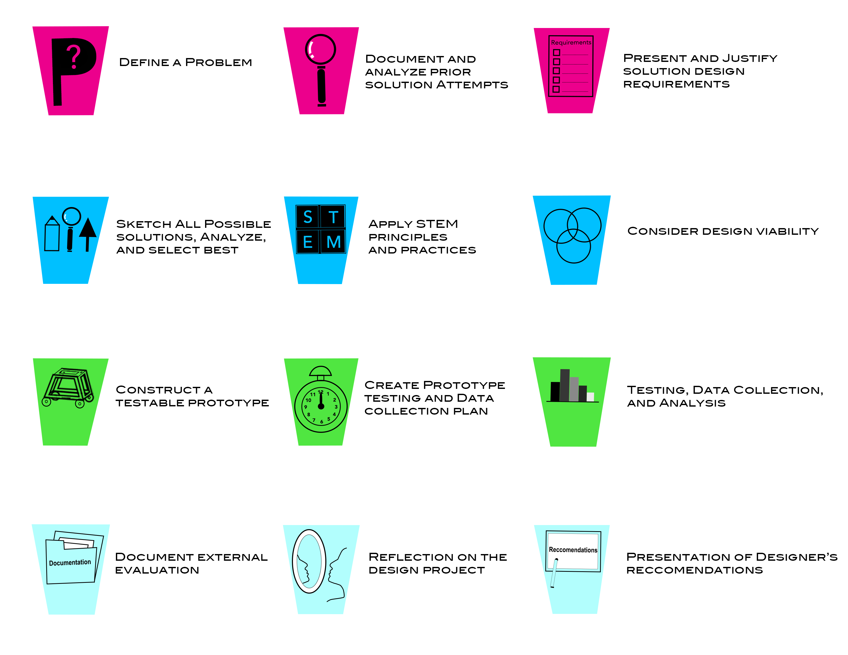

Slide 9
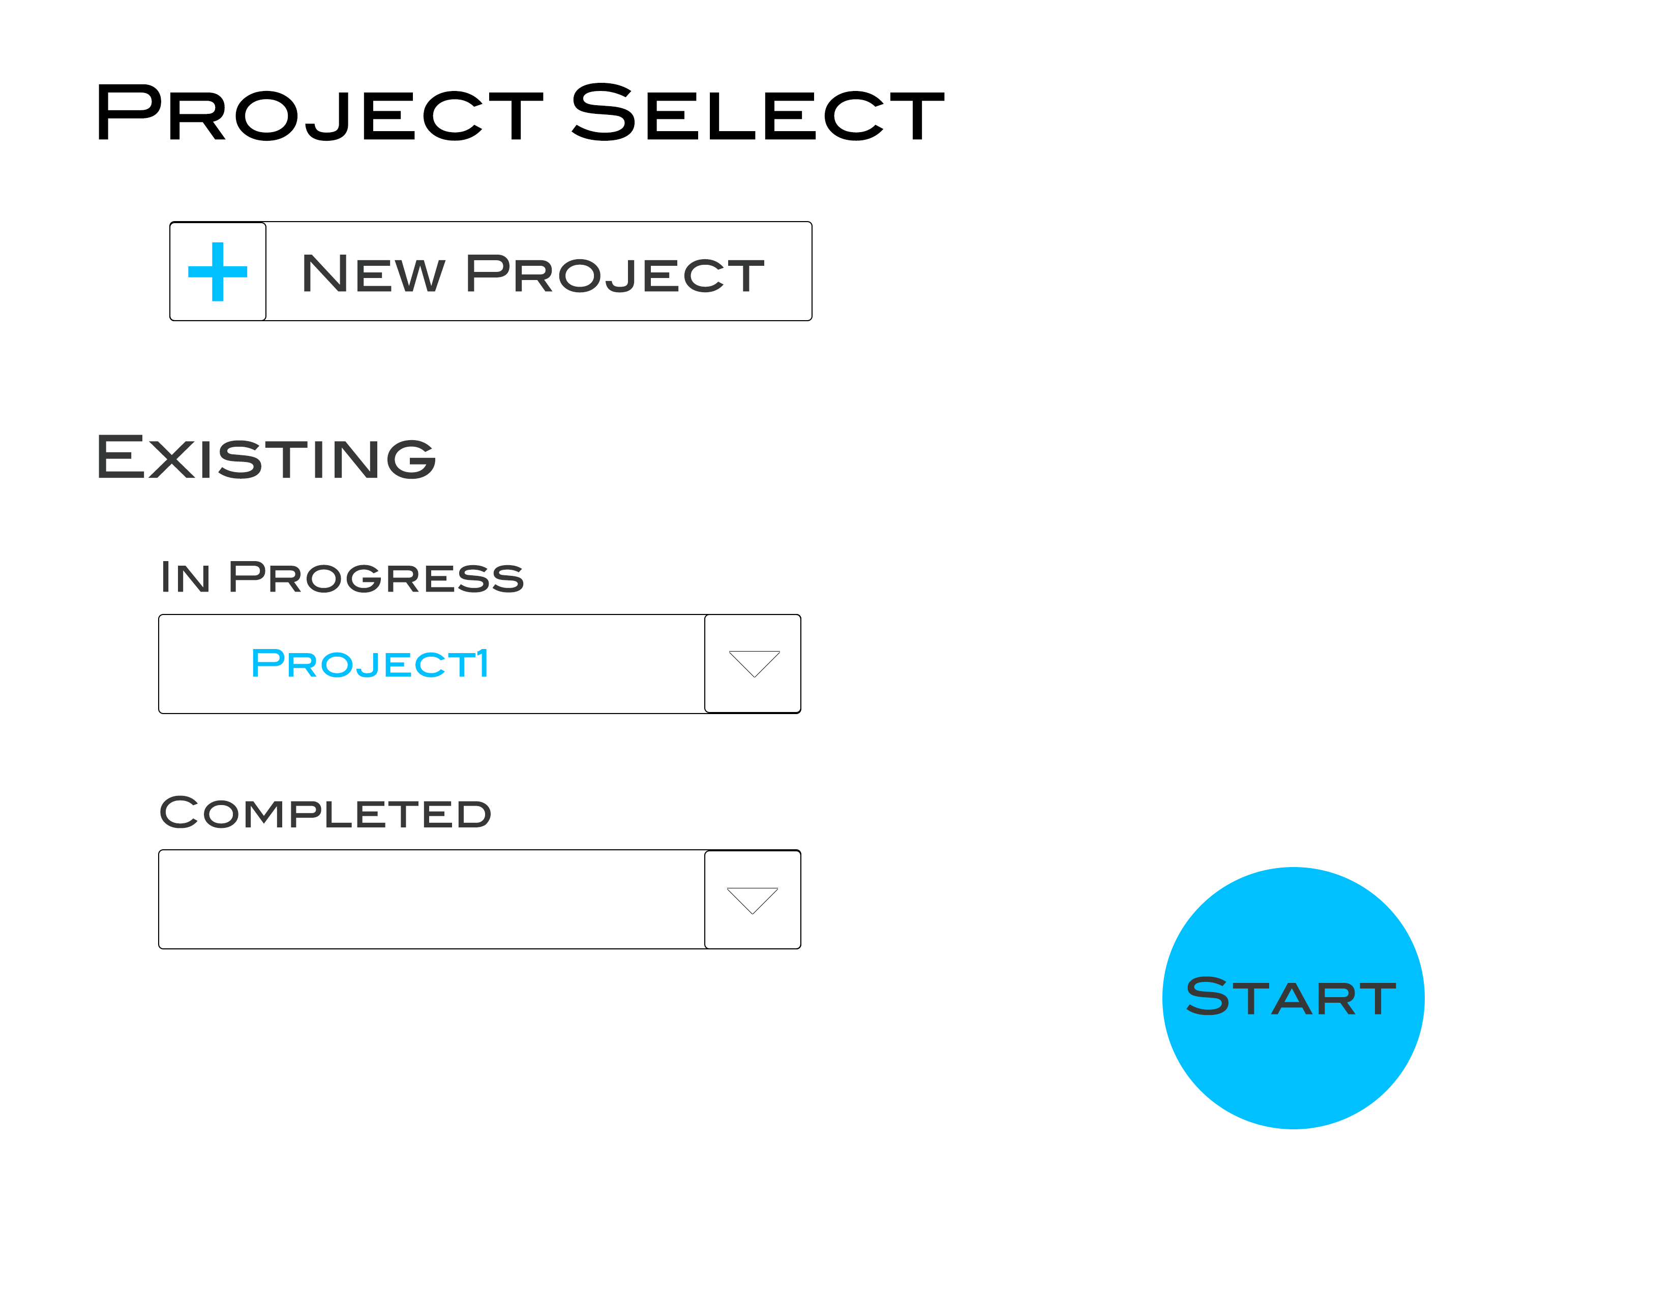
MyDesign
CLICK HERE
Suppose you wanted to choose an existing project?

Slide 10
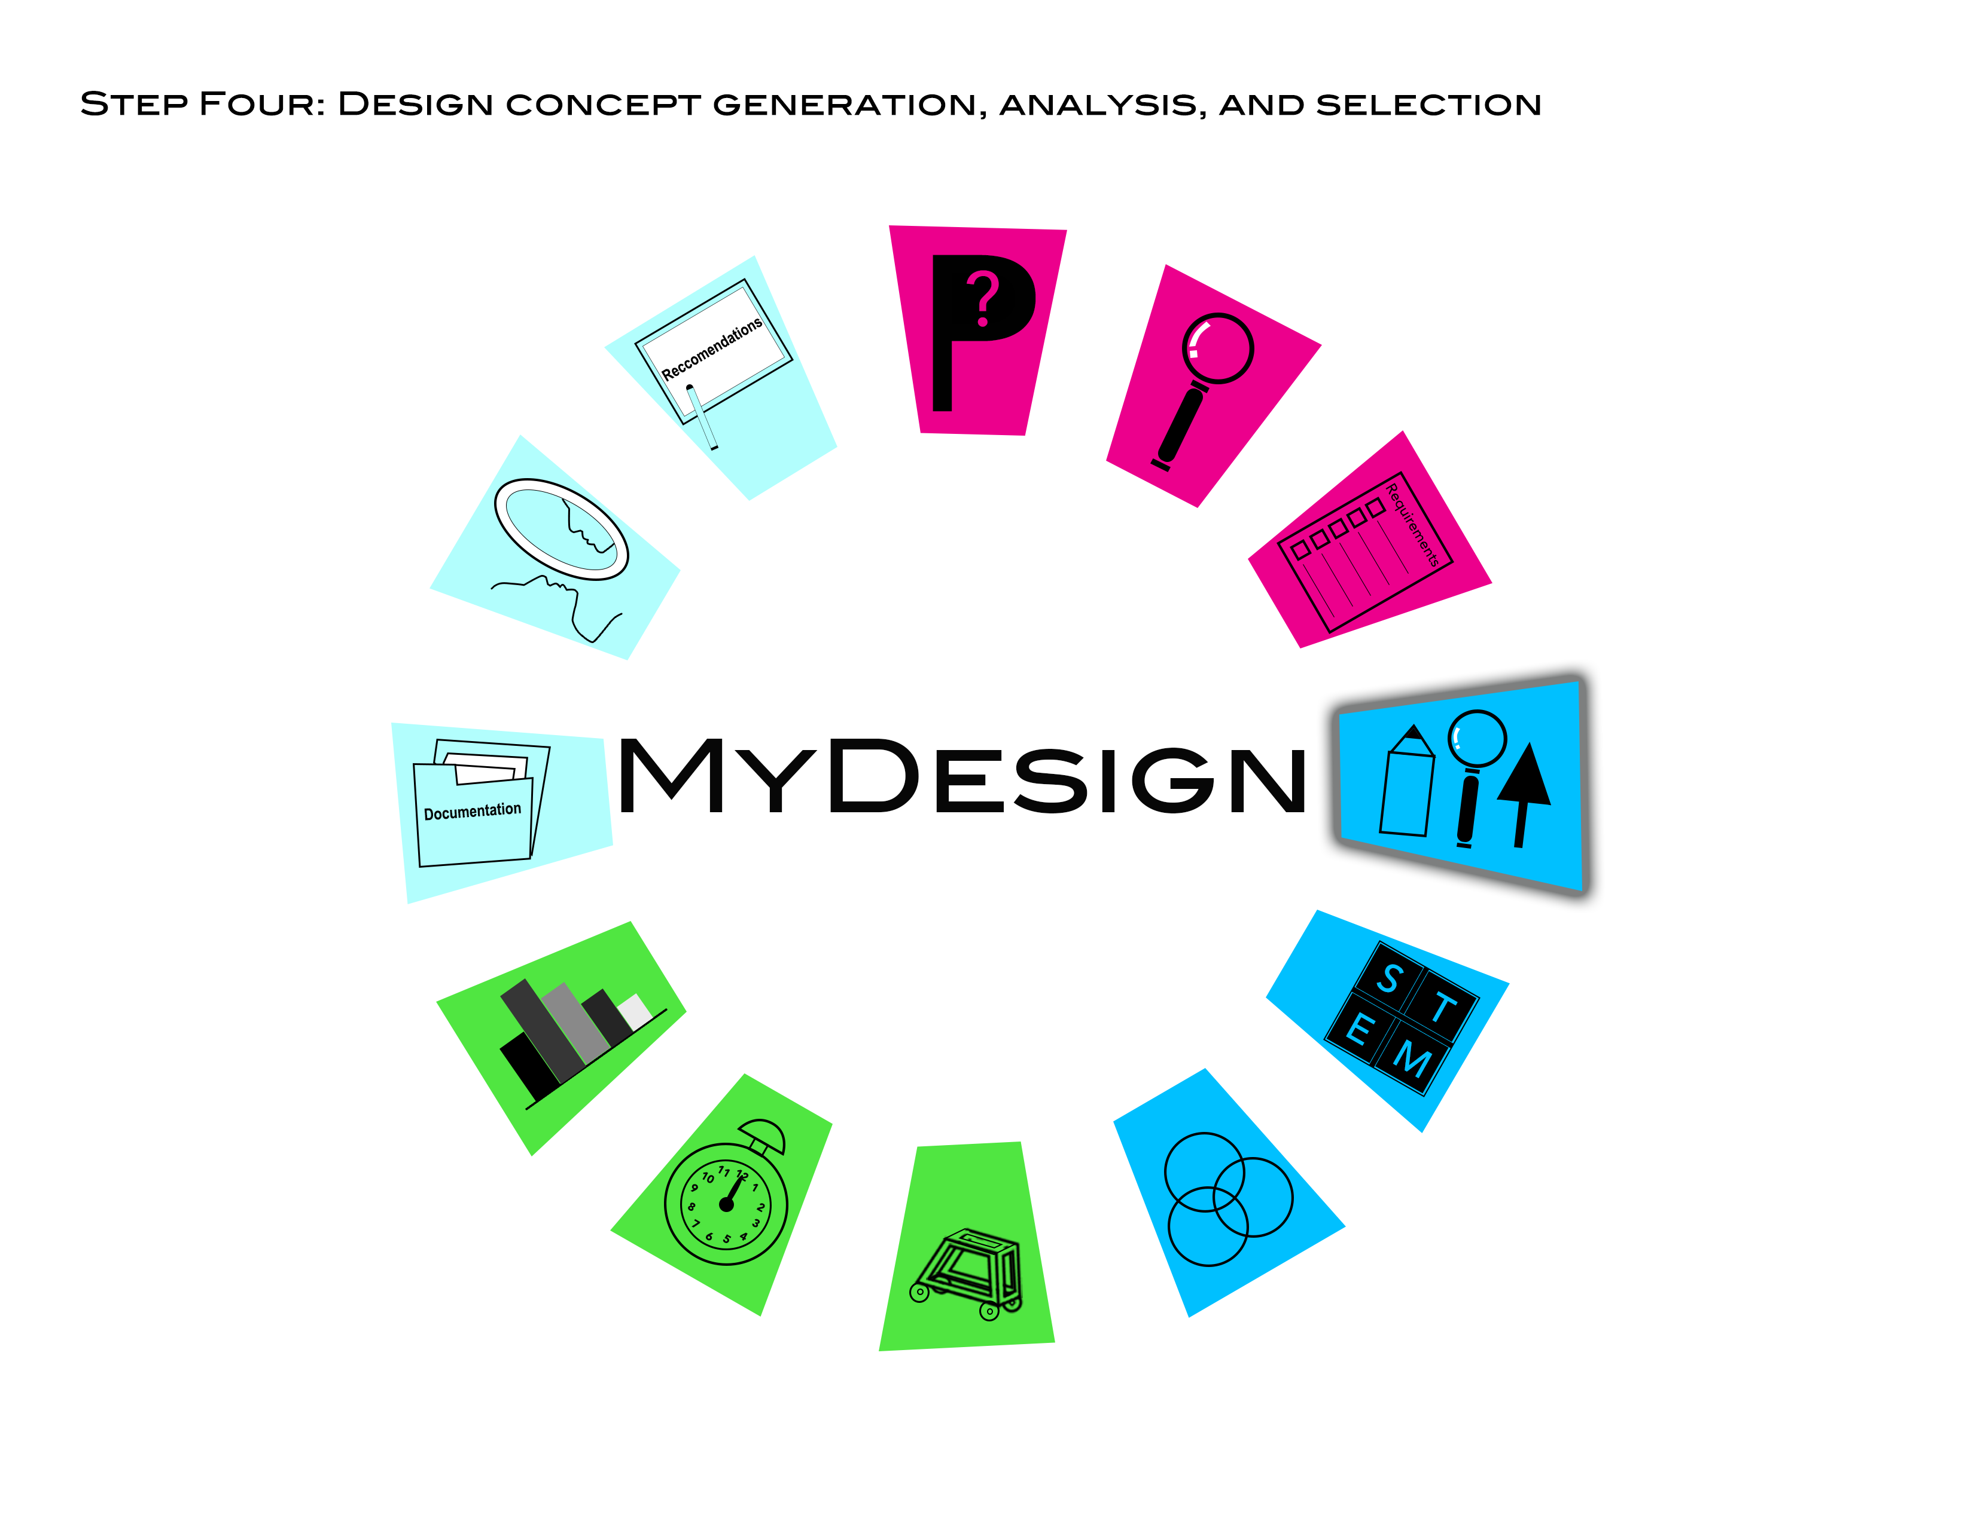


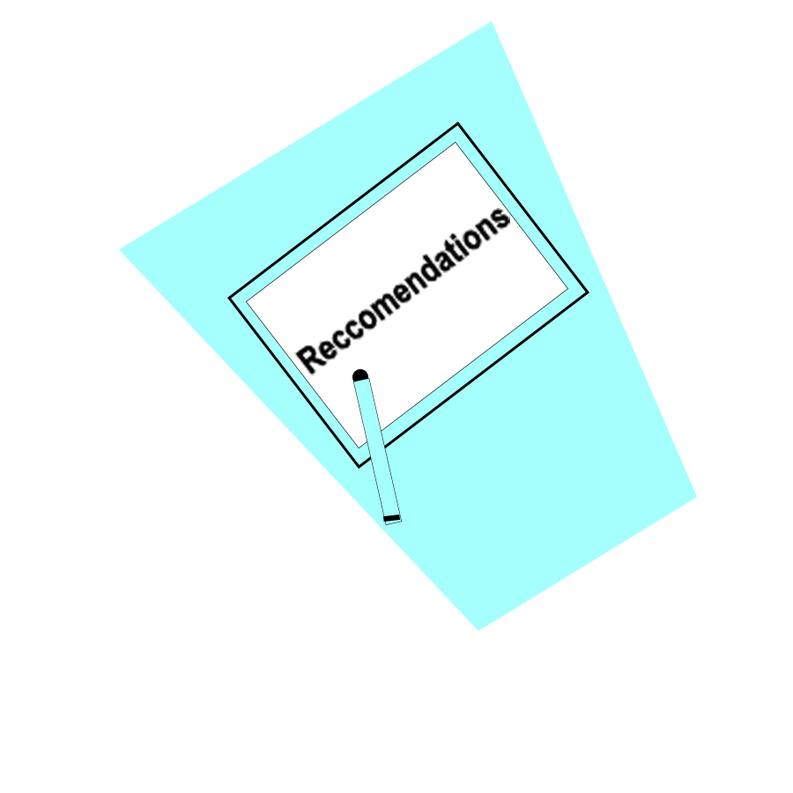


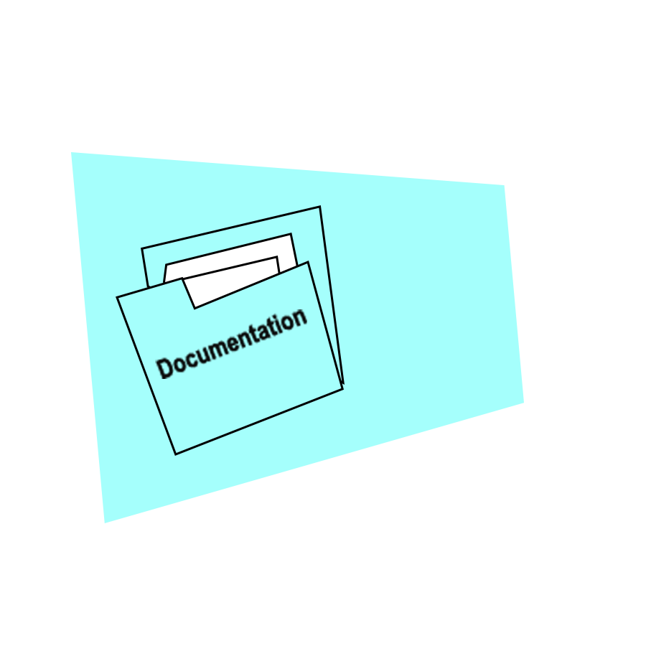





MyDesign
Highlights the step the user left off of
CLICK HERE

Slide 11

MyDesign
Highlights the step the user left off of
CLICK HERE

Slide 12

MyDesign
Highlights the step the user left off of
CLICK HERE

Slide 13
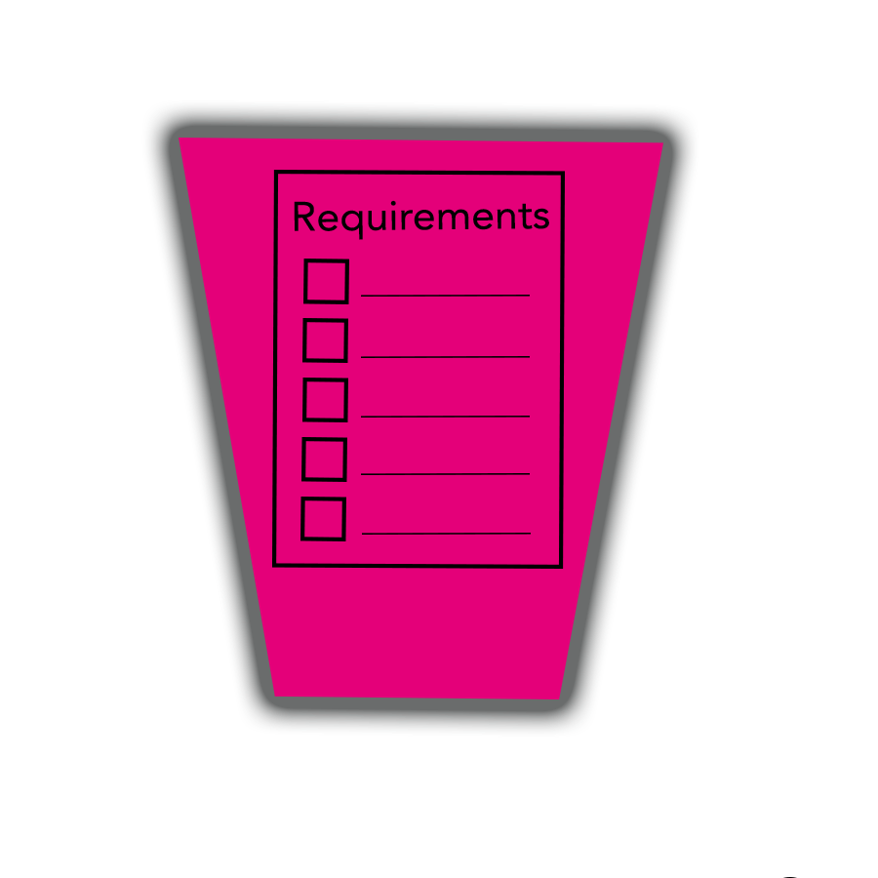
MyDesign
Highlights the step the user left off of
CLICK HERE

Slide 14

MyDesign
Highlights the step the user left off of
CLICK HERE

Slide 15

MyDesign
Highlights the step the user left off of
CLICK HERE

Slide 16

MyDesign
Highlights the step the user left off of
CLICK HERE

Slide 17

MyDesign
Highlights the step the user left off of
CLICK HERE

Slide 18

MyDesign
Highlights the step the user left off of
CLICK HERE

Slide 19
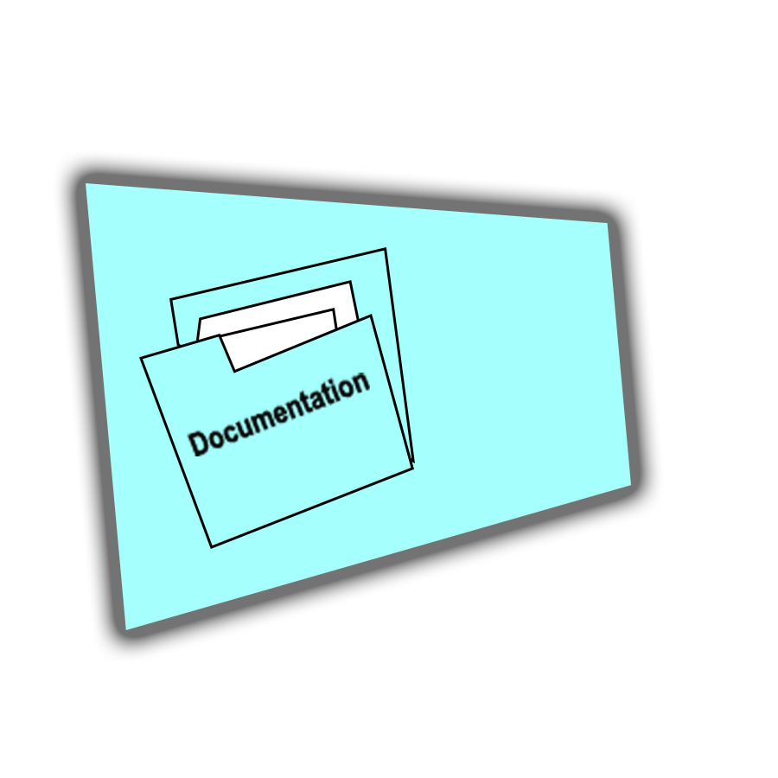
MyDesign
Highlights the step the user left off of
CLICK HERE

Slide 20

MyDesign
Highlights the step the user left off of
CLICK HERE

Slide 21

MyDesign
Highlights the step the user left off of
CLICK HERE

Slide 22
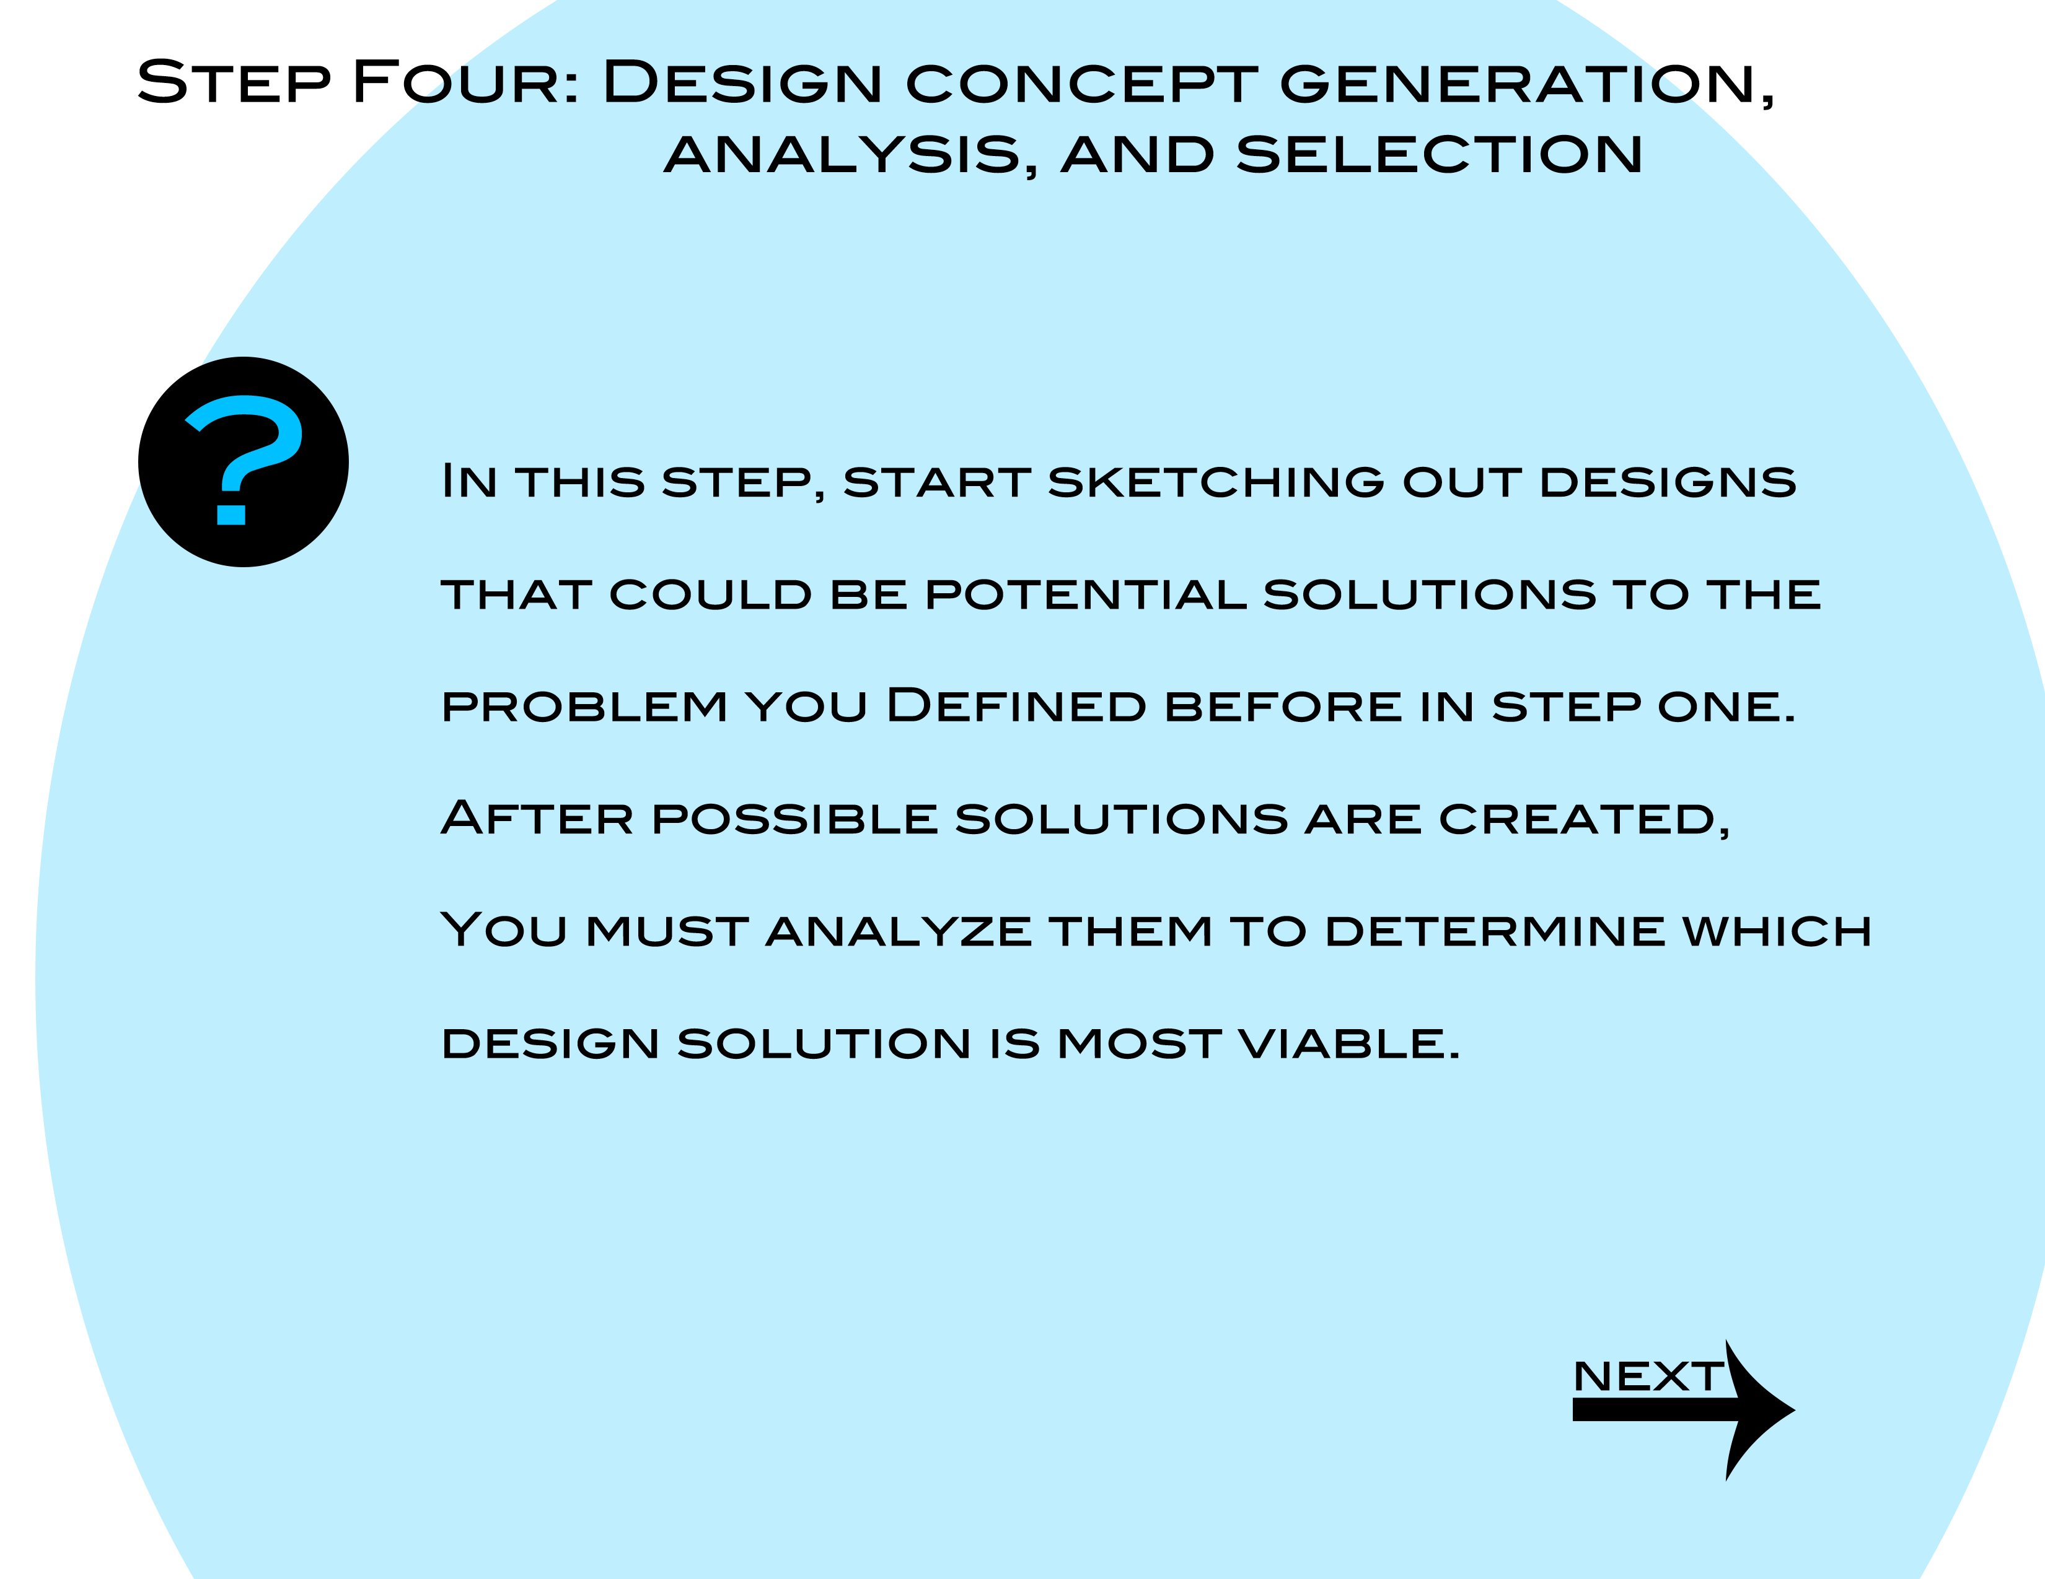
MyDesign
*Summary of step

Slide 23
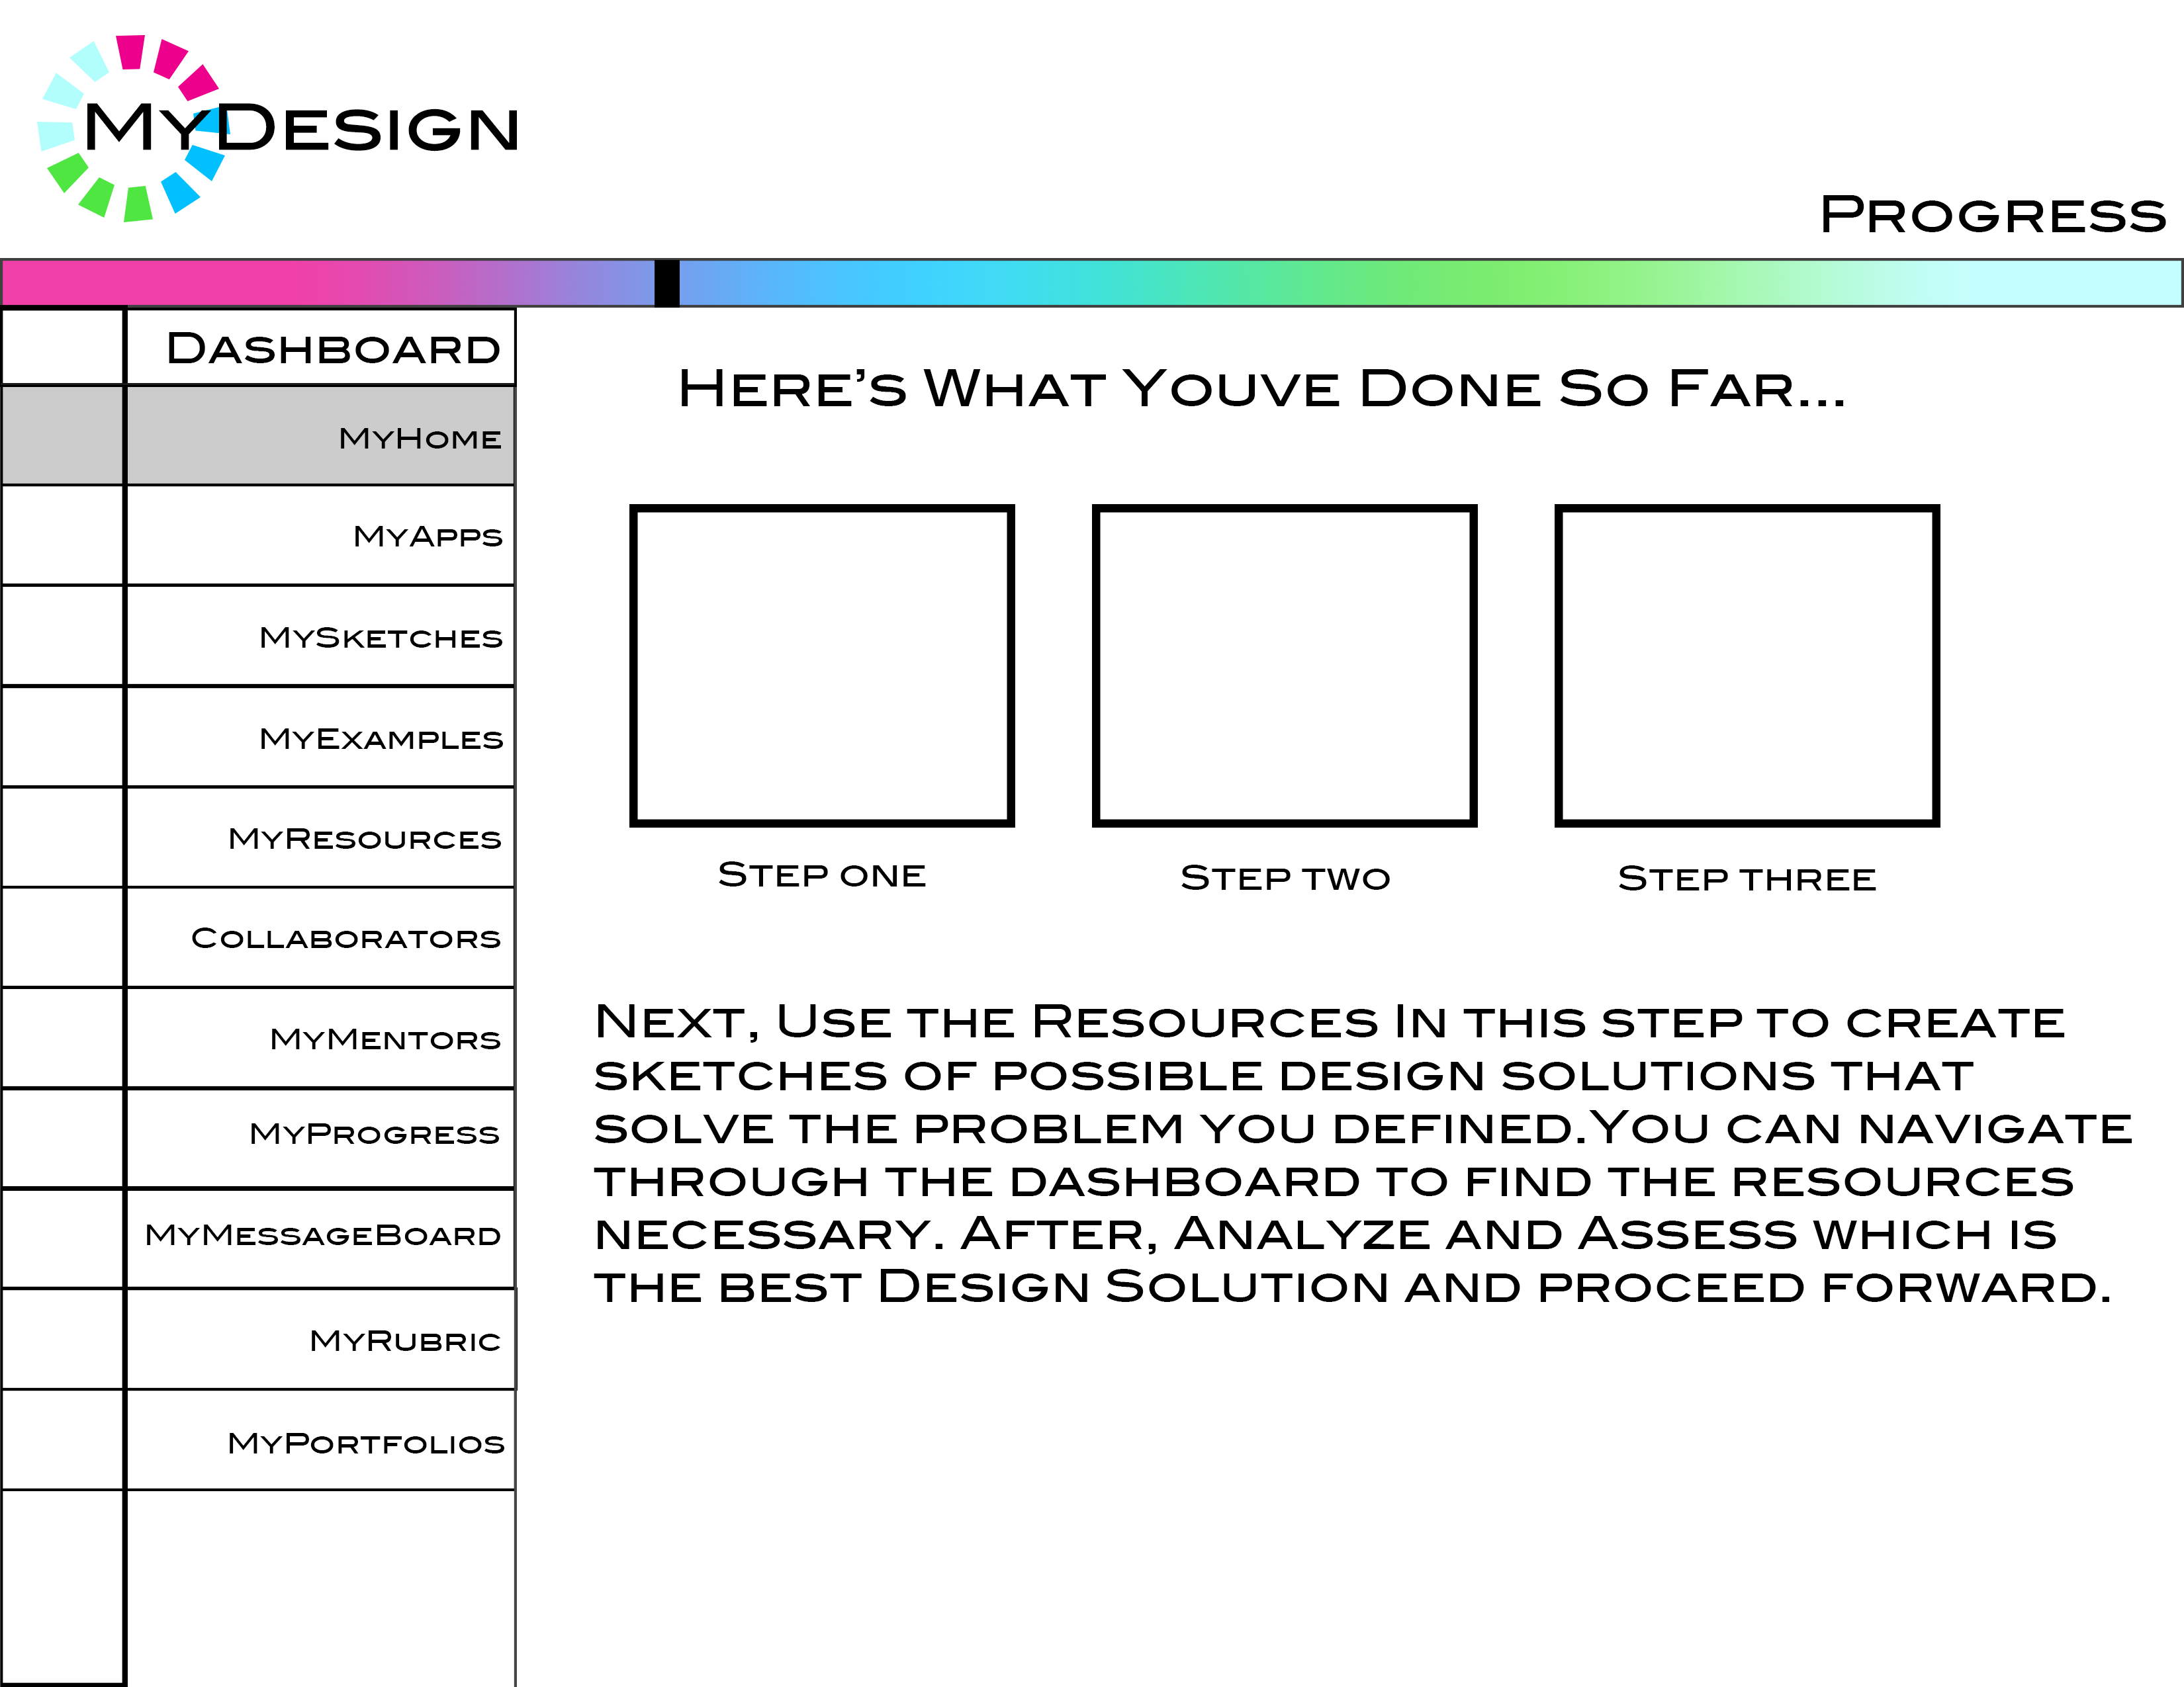
MyDesign
CLICK HERE

Slide 24
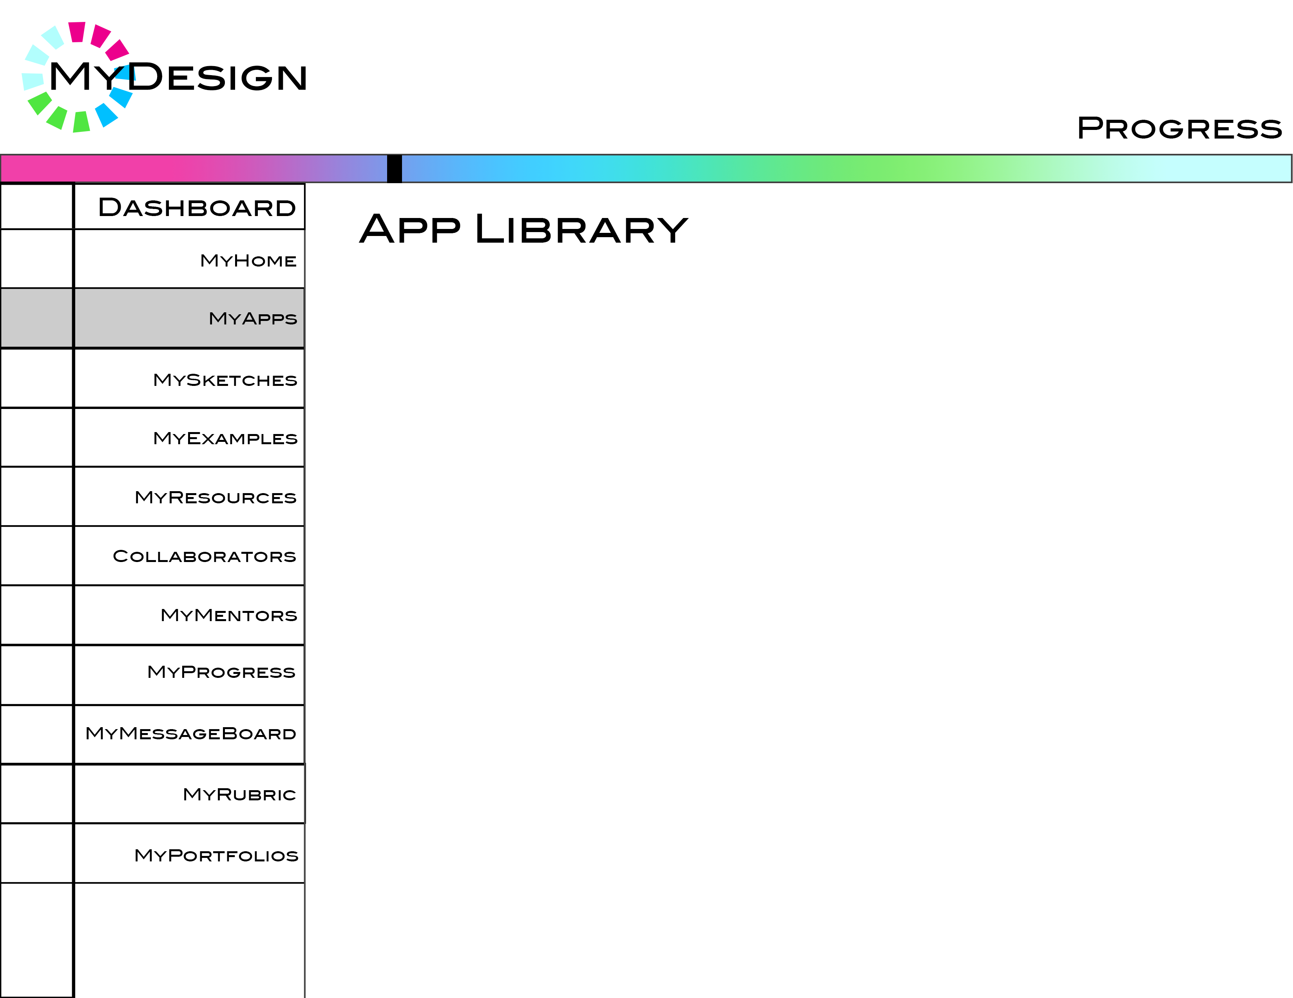
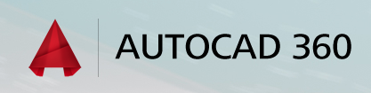
MyDesign
https://client.autocad360.com/createaccount.html
CLICK LINK

Slide 25
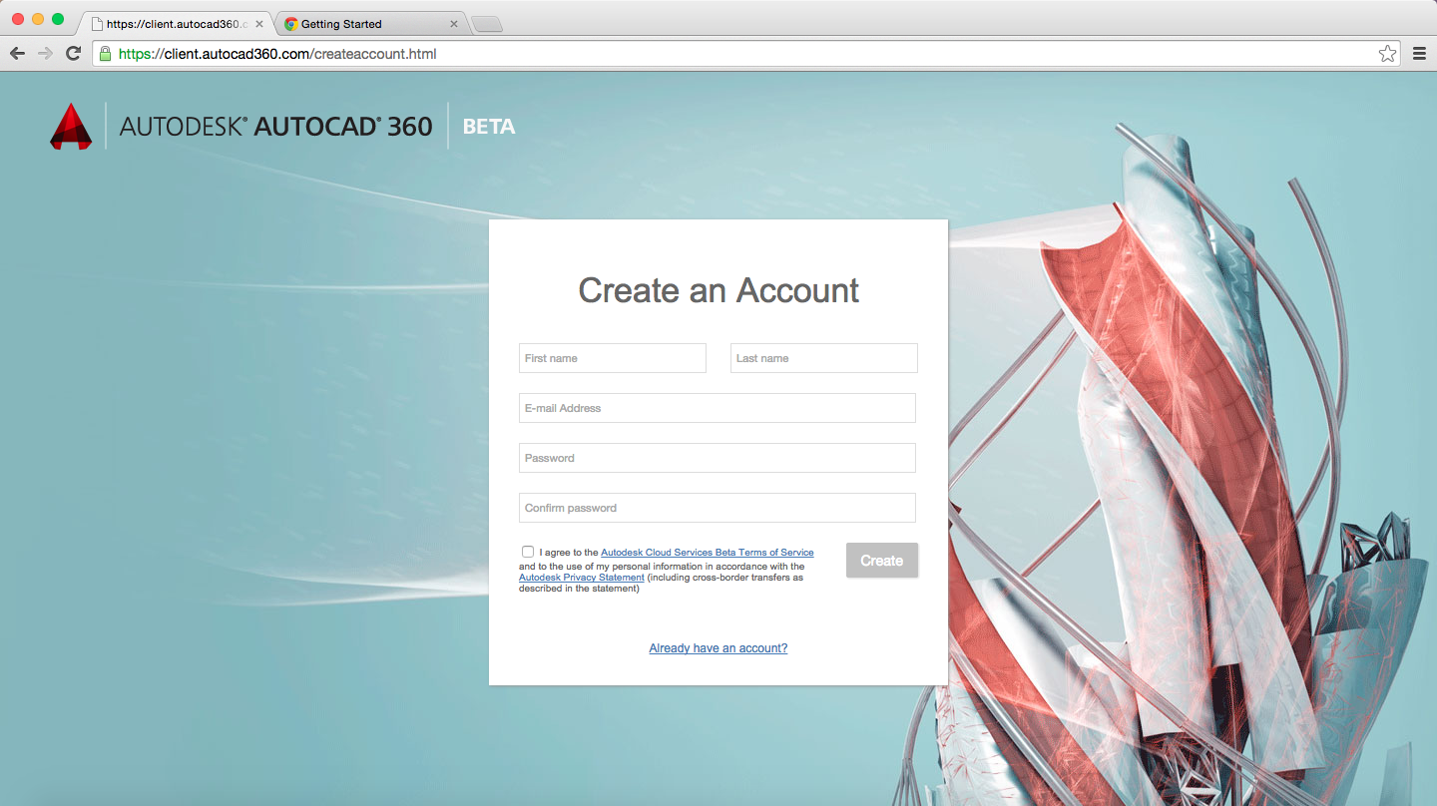
User will sign up for an account with Autodesk AutoCAD 360
MyDesign

Slide 26
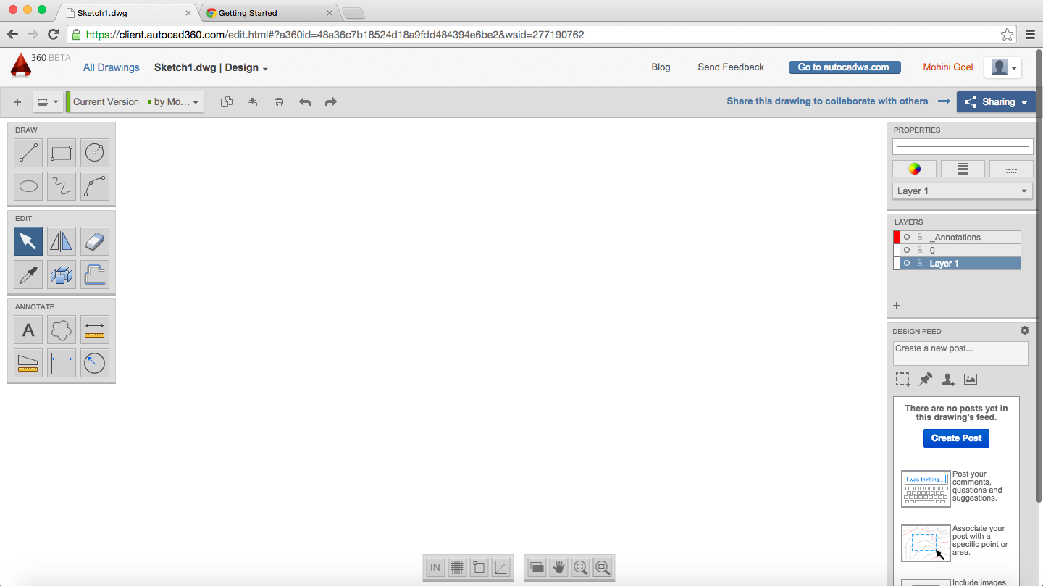
User can create sketches in AutoCAD 360
MyDesign

Slide 27
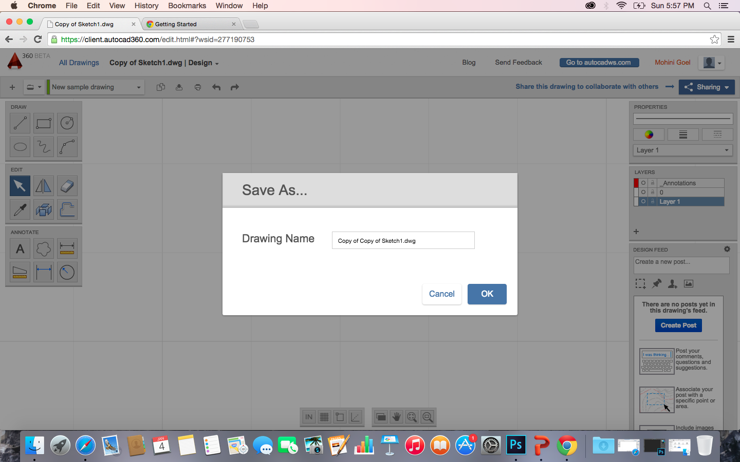
Save them as .dwg files
MyDesign

Slide 28
User can click back to the MyDesign Tab
MyDesign

Slide 29

MyDesign
https://client.autocad360.com/createaccount.html
CLICK HERE

Slide 30
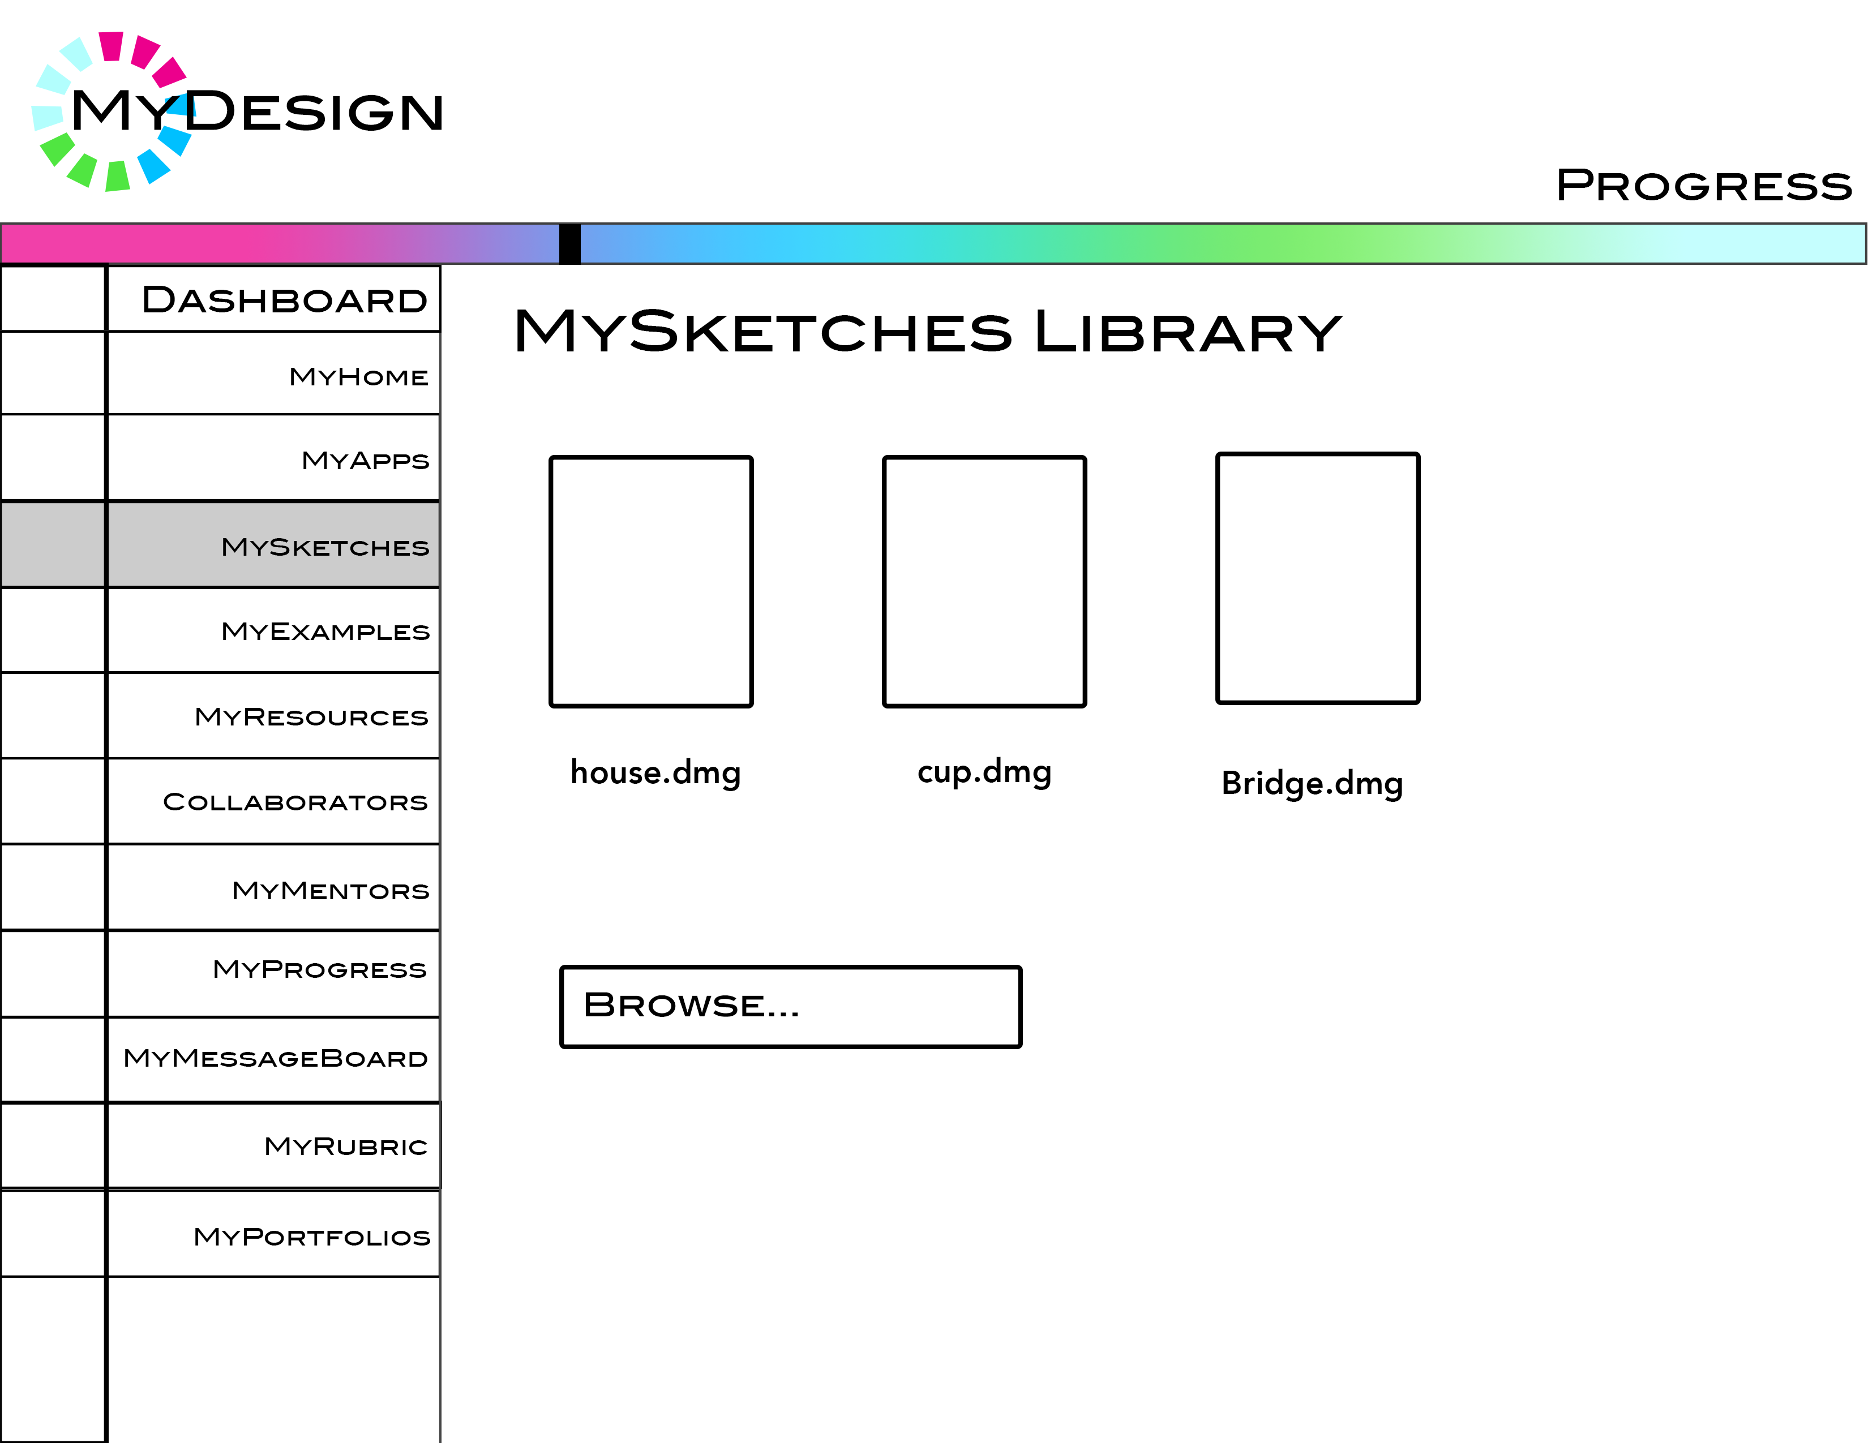
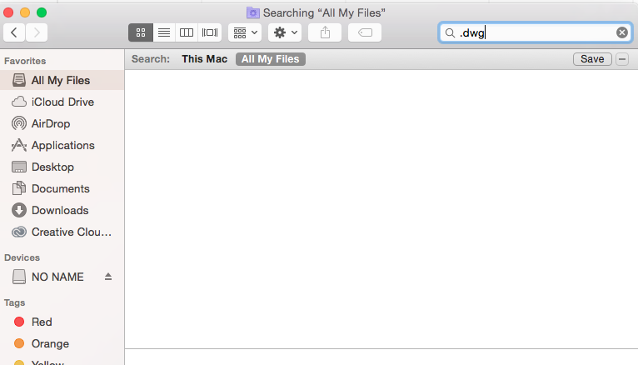
MyDesign
CHOOSE SKETCH FILE
Sketch1.dwg
CLICK BROWSE

Slide 31
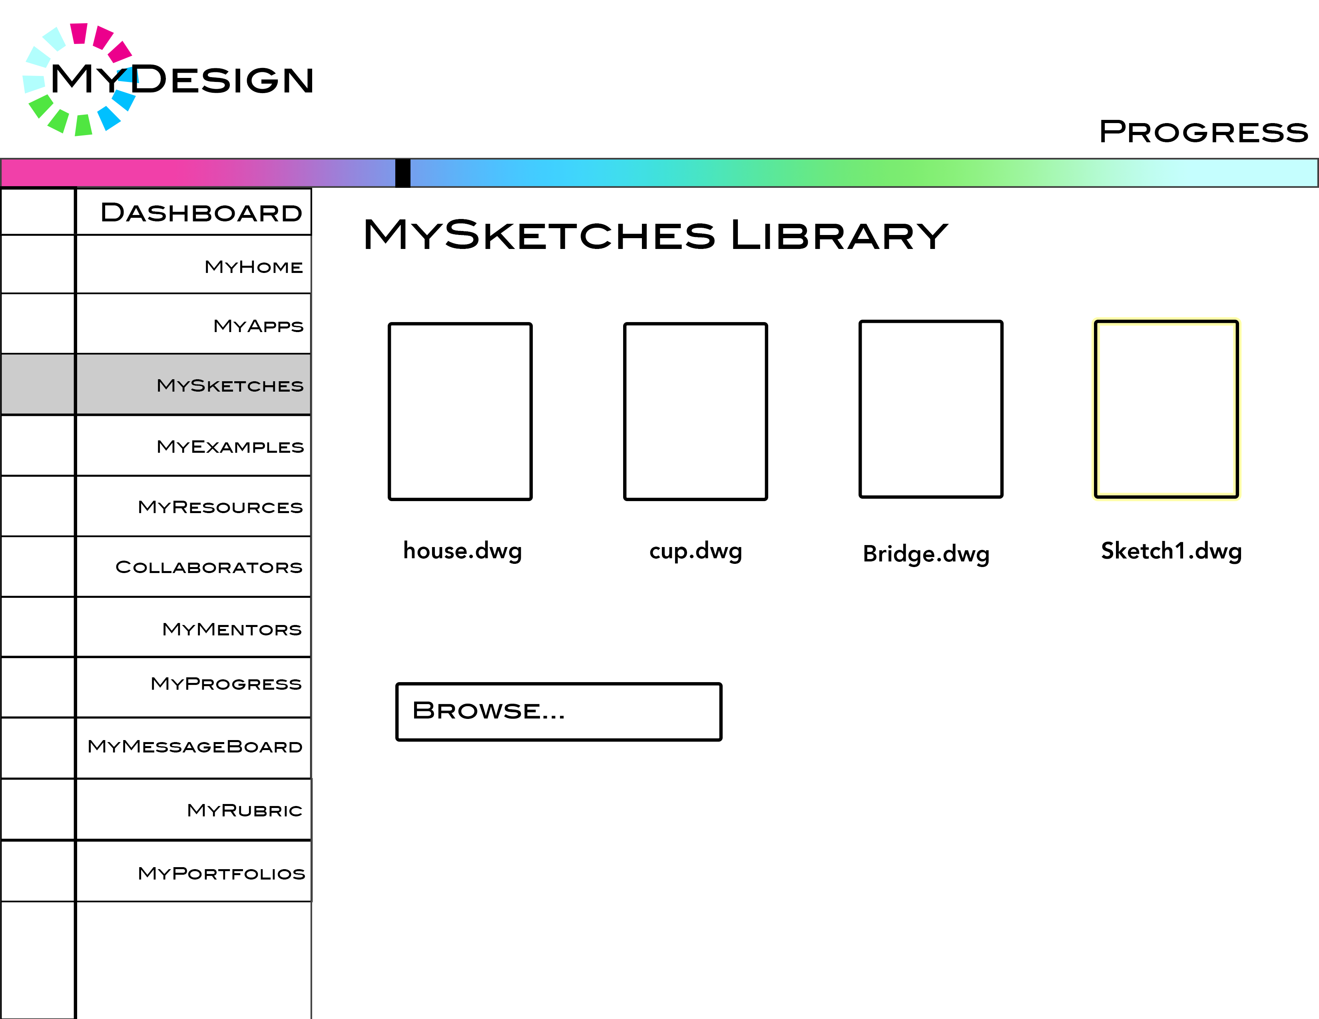
MyDesign

